Slide 1

Week 4
Windows Artefacts
& Registry Forensics
Presentation & reusable one-page cheat-sheet
Group 10 | Digital Forensics Internship

Slide 2
What this week is meant to achieve
A clean share-out plus a reusable reference for Windows artefacts
🎤
Deliverable 1: Share-out presentation
📄
Deliverable 2: One-page cheat-sheet
🧾
Deliverable 3: Short report summary
Summarise the weekly learning: what Windows artefacts were checked, which tools were used, and what evidence each artefact can prove.
Build a quick reference with hive files, key registry paths, artefact purpose, tools, and investigator tips.
Explain the collective findings, common challenges, and key takeaways from the week.
Approach used in this deck
Collect and review available group outputs.
Map every artefact to the question it can answer.
Keep the cheat-sheet short, practical, and reusable.
Where group responses were not available, summarize by artefact theme and update during live discussion.
Group 10 | Week 4 - Windows Artefacts & Registry Forensics
02

Slide 3
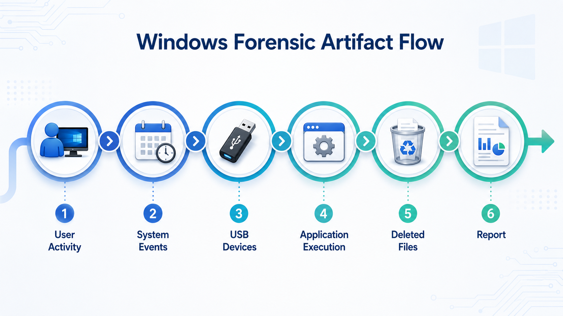
Windows artefact map
Different evidence sources answer different investigation questions
👤
User activity
💻
System & device activity
🧩
Application & file activity
RunMRU, RecentDocs, TypedPaths, UserAssist, Jump Lists and NTUSER.DAT traces show what a user opened, typed, or executed.
SYSTEM hive, MountedDevices, USBSTOR and Event Logs help identify system settings, connected devices, and logon/logoff events.
Prefetch, Amcache, Recycle Bin, browser data and LNK files help prove execution, access, deletion, and document usage.
Group 10 | Week 4 - Windows Artefacts & Registry Forensics
03

Slide 4
Core registry hives
Quick guide to which hive answers which question
Hive
Main purpose
Useful artefacts
Example question
NTUSER.DAT
Per-user activity
RunMRU, RecentDocs, UserAssist, TypedPaths
What did this user do?
SYSTEM
Hardware and system settings
USBSTOR, MountedDevices, TimeZone, ComputerName
Was a USB connected?
SOFTWARE
Installed apps and Windows info
Uninstall, Run, Windows NT CurrentVersion
Which software was installed?
SAM / SECURITY
Accounts and policies
Local users, policy settings
Which accounts exist?
USRCLASS.DAT
Shell activity
ShellBags, folder view traces
Which folders were viewed?
Practical reminder: work on forensic copies or exported hives, not live evidence. Record hash values when possible.
Group 10 | Week 4 - Windows Artefacts & Registry Forensics
04

Slide 5
User activity artefacts
Most useful traces from NTUSER.DAT and Explorer activity
⌨️
RunMRU
📑
RecentDocs
🚀
UserAssist
📁
TypedPaths
Shows commands typed in the Windows Run box, such as cmd, powershell, regedit, notepad, or suspicious utilities.
Shows recently opened files and file-type categories. Useful for proving document access or file interaction.
Stores GUI program execution traces. Names may require ROT13 decoding and deeper Count key parsing.
Shows folder paths typed in File Explorer address bar. Useful for proving manual navigation.
What our available output showed
Artefact
Result
Meaning
RunMRU
Key found, no values
Path exists; Run history may be empty or cleared
RecentDocs
30 values, 6 subkeys
Strong evidence of recently opened files and categories
UserAssist
9 subkeys
Execution traces exist; needs deeper Count parsing
UserStartup
OneDrive value
User startup entry identified
Group 10 | Week 4 - Windows Artefacts & Registry Forensics
05

Slide 6
System and application artefacts
Sources that confirm device usage, software inventory, and execution
🔌
USBSTOR + MountedDevices
⚙️
Prefetch + Amcache
🗑️
Event Logs + Recycle Bin
USBSTOR can show vendor/product/serial traces. MountedDevices helps map volumes and drive letters.
Prefetch can show program execution and run count. Amcache can support execution and file metadata analysis.
Security/System logs show logon, logoff, and device activity. Recycle Bin traces deletion and original paths.
How we combine evidence
Use registry artefacts for user/system context.
Use Prefetch/Amcache/Event Logs to confirm execution or timeline.
Use Recycle Bin/LNK/RecentDocs to prove document access or deletion.
Always cross-check timestamps; one artefact alone is rarely enough.
Group 10 | Week 4 - Windows Artefacts & Registry Forensics
06

Slide 7
Weekly share-out summary
Compiled by artefact theme because full group responses were not available before submission
Theme
Common tools
Main finding to present
Registry user activity
Registry Explorer, Python parser
NTUSER.DAT can reveal RecentDocs, UserAssist, RunMRU and TypedPaths.
USB/device traces
SYSTEM hive, Event Viewer
USBSTOR and MountedDevices help identify storage devices and drive mapping.
Execution history
Prefetch viewers, Amcache tools
Prefetch/UserAssist/Amcache should be combined for stronger proof of execution.
File access/deletion
RecentDocs, LNK, Recycle Bin, Autopsy
RecentDocs and Recycle Bin connect documents with access and deletion behavior.
Reporting practice
Screenshots, CSV/PDF export
Findings are clearer when evidence path, timestamp and tool output are recorded.
Live update note: if groups provide their exact data during meeting, insert it into this table before final submission.
Group 10 | Week 4 - Windows Artefacts & Registry Forensics
07

Slide 8
One-page cheat-sheet preview
The report contains this content in a printable one-page reference
Artefact
Hive/File
Registry path or location
What it tells
RunMRU
NTUSER.DAT
...\Explorer\RunMRU
Commands typed in Run box
RecentDocs
NTUSER.DAT
...\Explorer\RecentDocs
Recently opened files/categories
UserAssist
NTUSER.DAT
...\Explorer\UserAssist\{GUID}\Count
GUI program execution traces
TypedPaths
NTUSER.DAT
...\Explorer\TypedPaths
Manually typed Explorer paths
USBSTOR
SYSTEM
ControlSet001\Enum\USBSTOR
Connected USB storage devices
Installed Apps
SOFTWARE
...\CurrentVersion\Uninstall
Installed software inventory
Startup Apps
NTUSER/SOFTWARE
...\CurrentVersion\Run
Auto-start programs
✅
Investigator tips
Make a forensic copy first; record path + timestamp + screenshot; compare multiple artefacts before concluding; export CSV/PDF for final reporting.
Group 10 | Week 4 - Windows Artefacts & Registry Forensics
08

Slide 9
Key takeaways and closing
What everyone should remember after the Week 4 share-out
🧠
1. Registry is powerful, but contextual
🧭
2. Evidence path matters
📌
3. Cheat-sheet improves speed
Registry hives give strong user, system and software traces, but findings should be verified with file-system and event evidence.
Every finding should include source hive, registry path, timestamp, tool used and screenshot/output reference.
A reusable one-page reference helps all groups remember which artefact answers which investigation question.
Q&A / Discussion
Suggested discussion question: Which artefact is strongest for proving user activity, and which second source should confirm it?
Group 10 | Week 4 - Windows Artefacts & Registry Forensics
09

